Slide 1
Fossils and Geological Time
Year 10 Pre-ATAR Science

Slide 2
Learning Objective
Understand how fossil records, geology and radioisotopic dating can be used to track changes of living things over time

Slide 3
Success criteria
Describe the ideal conditions for the formation of a fossil
State the type of rock that fossils are found in
Classify fossils as direct or indirect
Apply the law of superposition to find relative ages of fossils
Explain how radioisotopes can be used to give absolute ages

Slide 4


Slide 5
What type of rock?
Best location?
Type of organism most likely to be fossilised?

Slide 6
Types of fossils

Slide 7
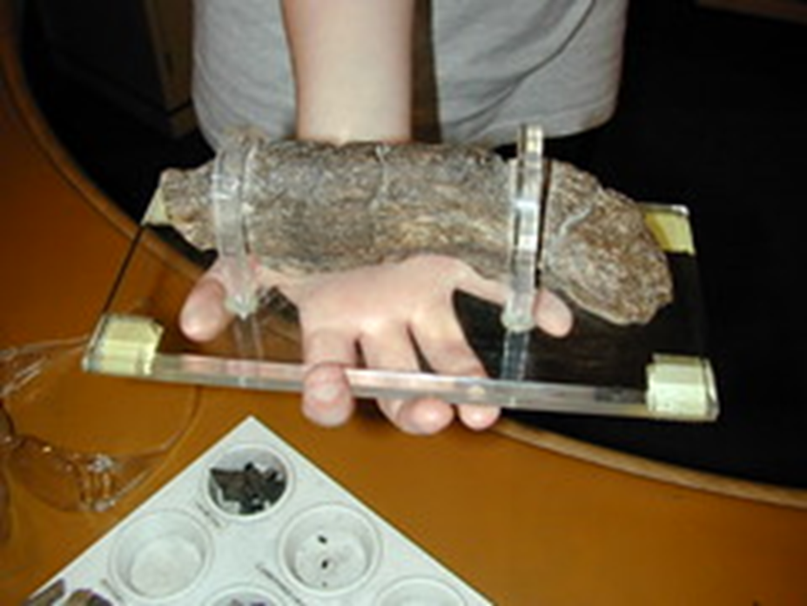
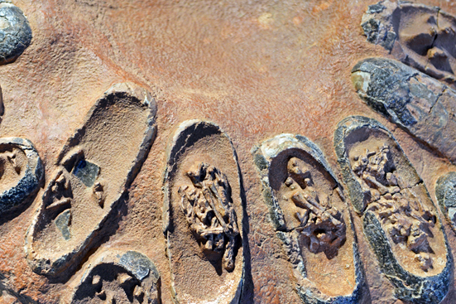
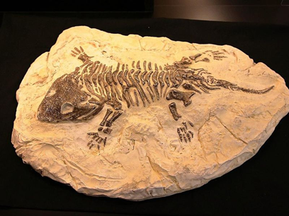
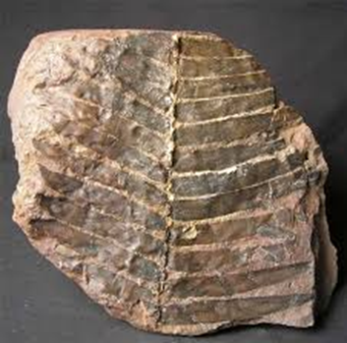
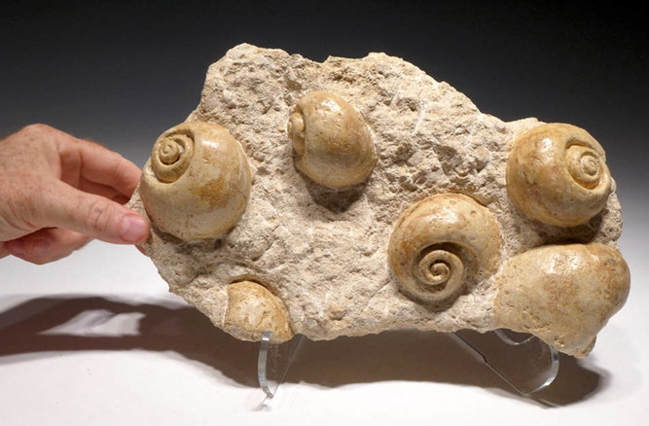
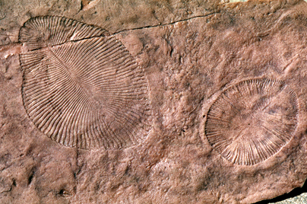
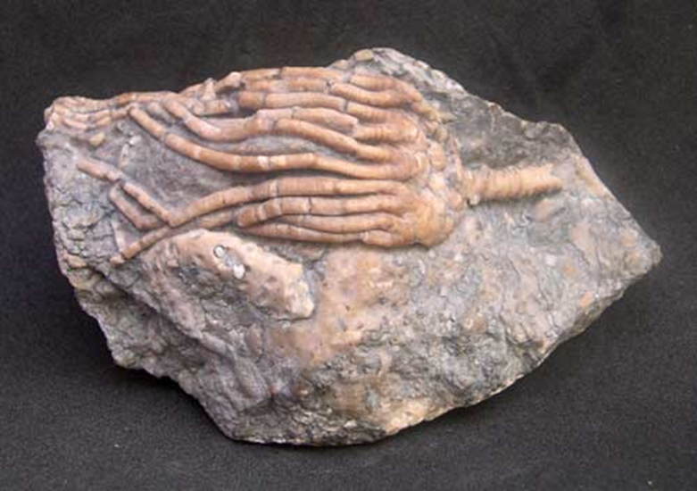
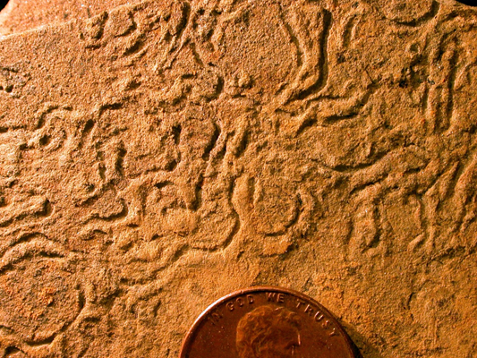
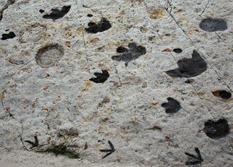
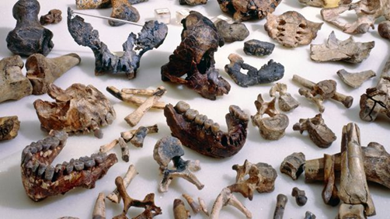
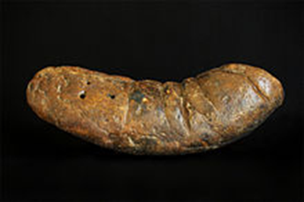
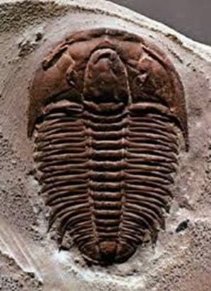
Types of fossils

Slide 8
Types of fossils
Direct – bodily remains | Indirect – left behind
bone shell leaves eggs | footprints tracks imprints poop

Slide 9
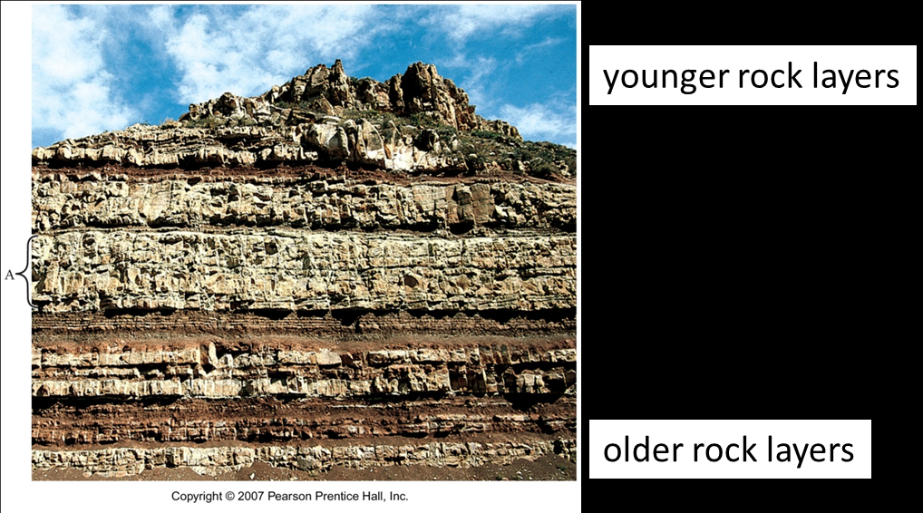
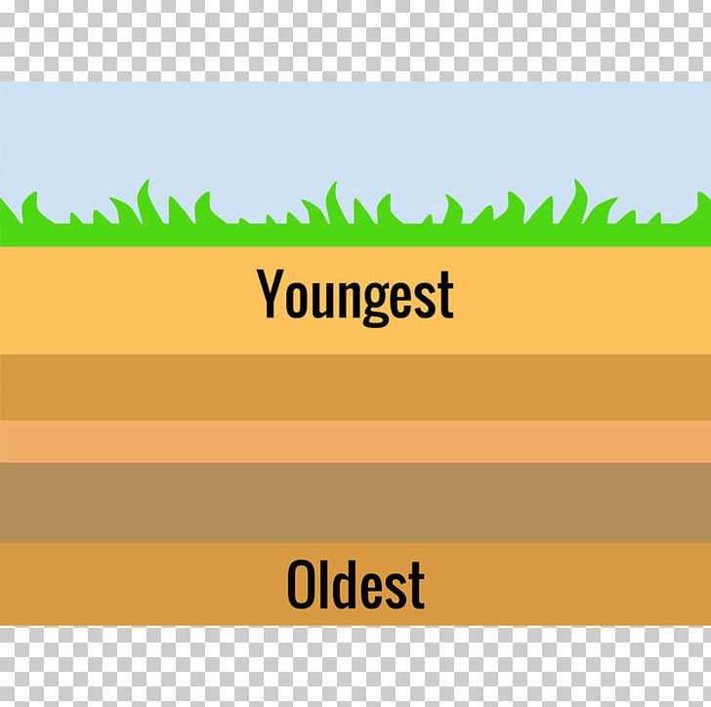
Geological time – Law of superposition

Slide 10
But rocks don’t tend to stay put!
What shifts rocks around underground?
What types of movement do they undergo?
What about other types of rocks?

Slide 11
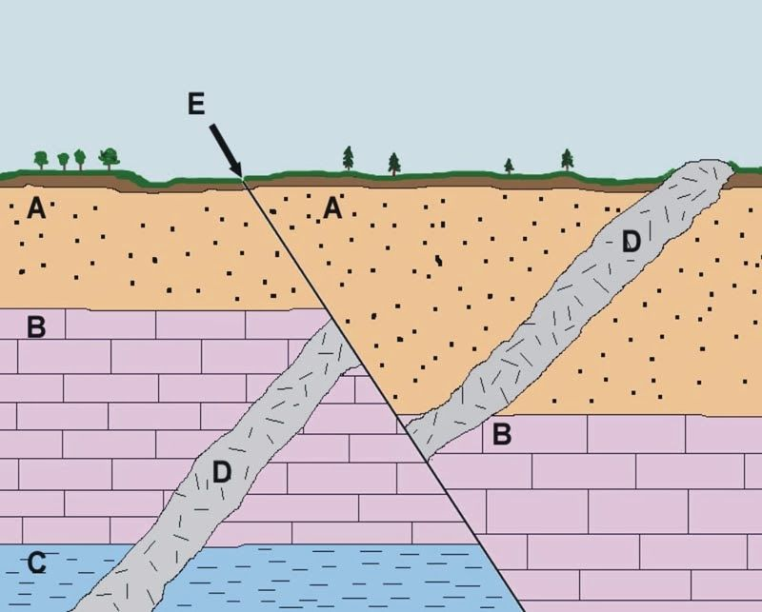
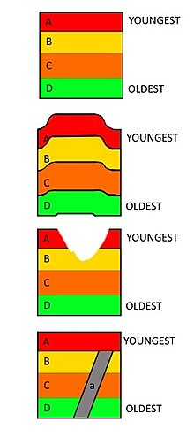

Slide 12
Relative dating
Comparing the age of a fossil or rock, relative to their surrounding fossils or rock layers – older or younger
Estimate only
Index fossils can be used to compare different locations

Slide 13
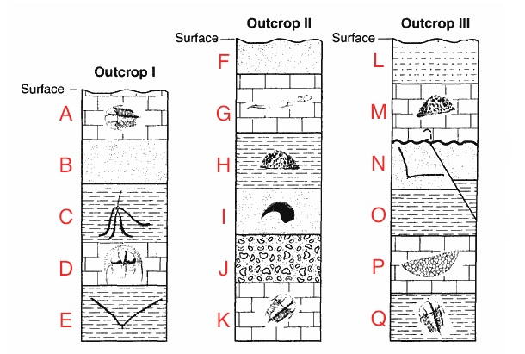

Slide 14
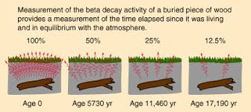
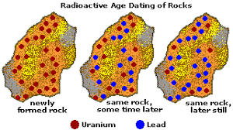
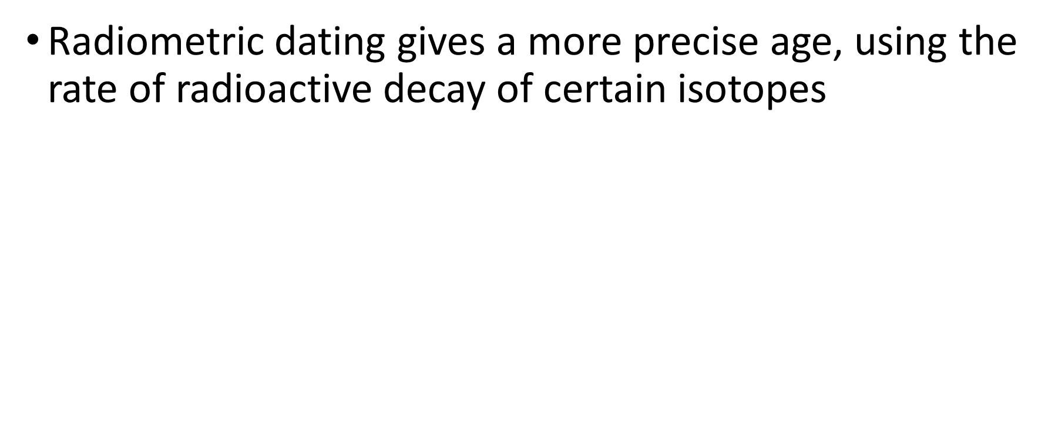
Radiometric (absolute) dating

Slide 15
Success criteria
Describe the ideal conditions for the formation of a fossil
State the type of rock that fossils are found in
Classify fossils as direct or indirect
Apply the law of superposition to explain relative ages of fossils
Explain how radioisotopes can be used to give absolute ages

